Slide 1



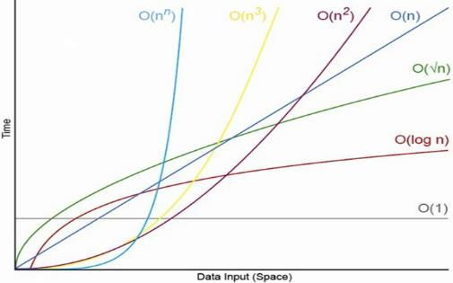
Data Structures, Algorithms and Complexity
O(n)
Analyzing Algorithm Complexity. Asymptotic Notation
Data
Structures
SoftUni Team
Technical Trainers
Software University
http://softuni.bg

Slide 2

Table of Contents
Data Structures
Linear Structures, Trees, Hash Tables, Others
Algorithms
Sorting and Searching, Combinatorics, Dynamic Programming, Graphs, Others
Complexity of Algorithms
Time and Space Complexity
Mean, Average and Worst Case
Asymptotic Notation O(g)
O(n)

Slide 3
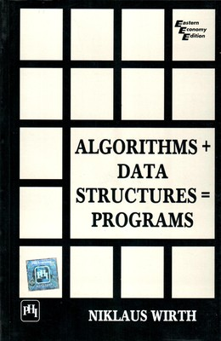

Slide 4
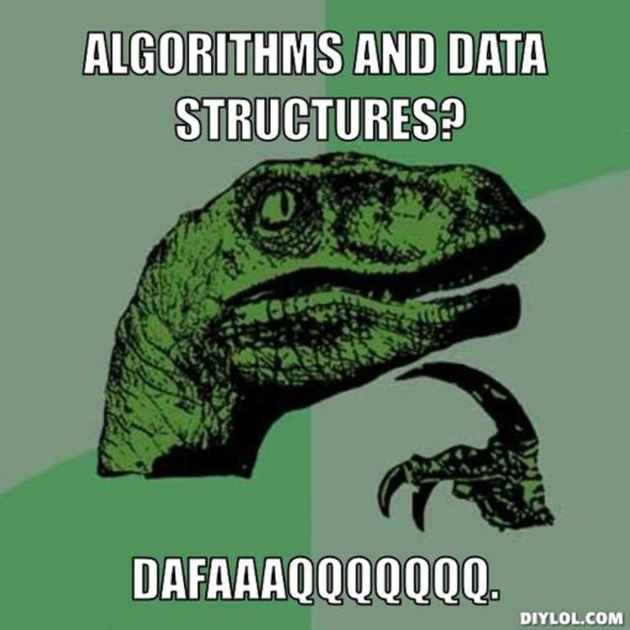

Slide 5
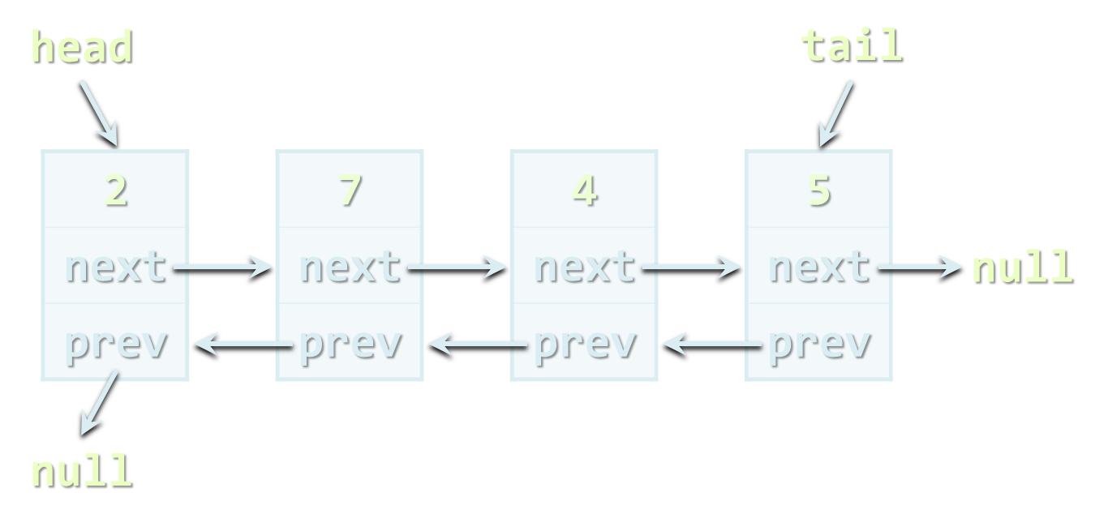
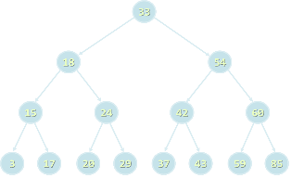
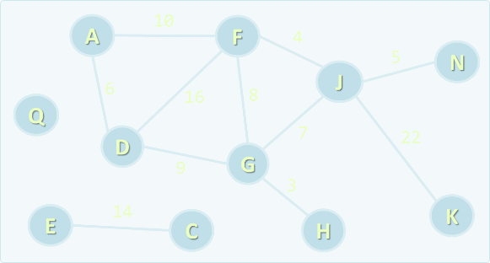
Data Structures
Overview

Slide 6
What is a Data Structure?
“In computer science, a data structure is a particular way of storing and organizing data in a computer so that it can be used efficiently.”
-- Wikipedia
Examples of data structures:
Person structure (first name + last name + age)
Array of integers – int[]
List of strings – List<string>
Queue of people – Queue<Person>

Slide 7
Student Data Structure
struct Student {
string Name { get; set; }
short Age { get; set; } // Student age (< 128)
Gender Gender { get; set; }
int FacultyNumber { get; set; }
};
enum Gender
{
Male,
Female,
Other
}
Student
Name
Maria Smith
Age
23
Gender
Female
FacultyNumber
SU2007333

Slide 8

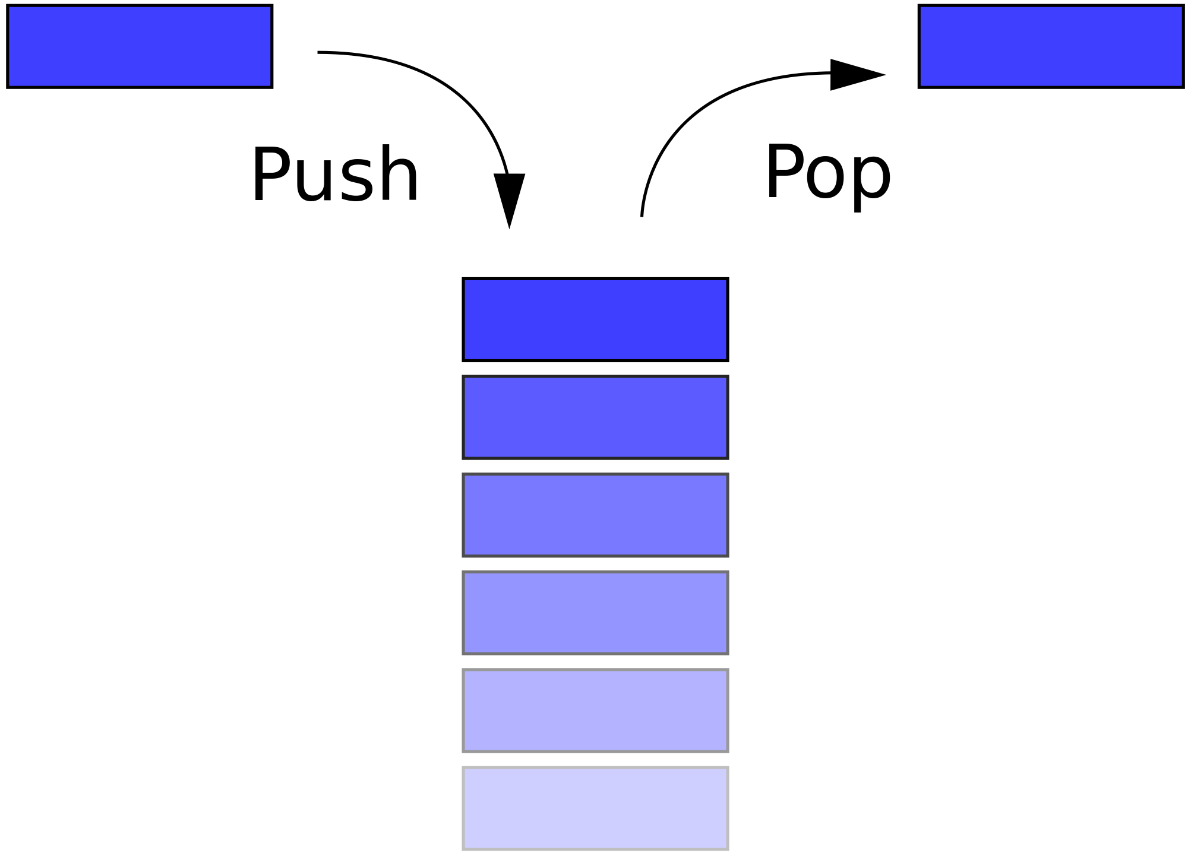
Stack

Slide 9
Stack
class Stack<T>
{
// Pushes an elements at the top of the stack
void Push(T data);
// Extracts the element at the top of the stack
T Pop();
// Checks for empty stack
bool IsEmpty();
}
// The type T can be any data structure like
// int, string, DateTime, Student

Slide 10
Stack
data
top of the stack
data
data
data
data
data
data

Slide 11
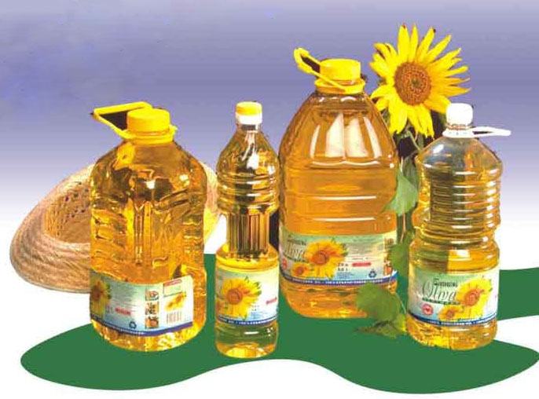
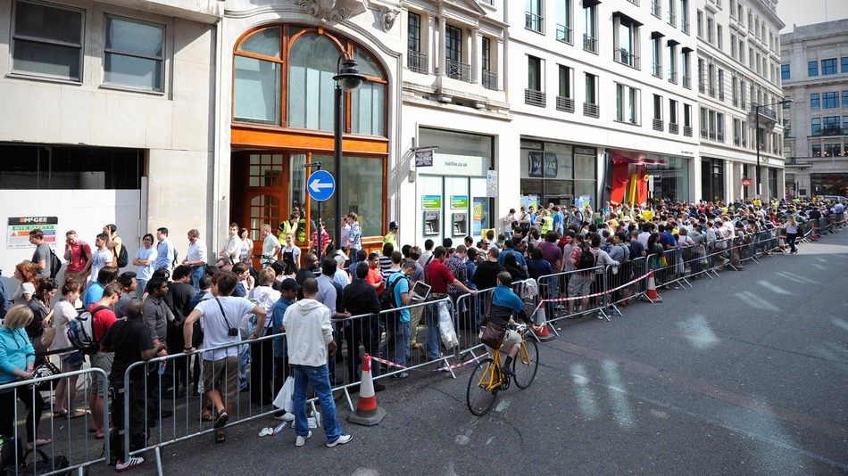
Queue

Slide 12


Queue

Slide 13


Queue

Slide 14
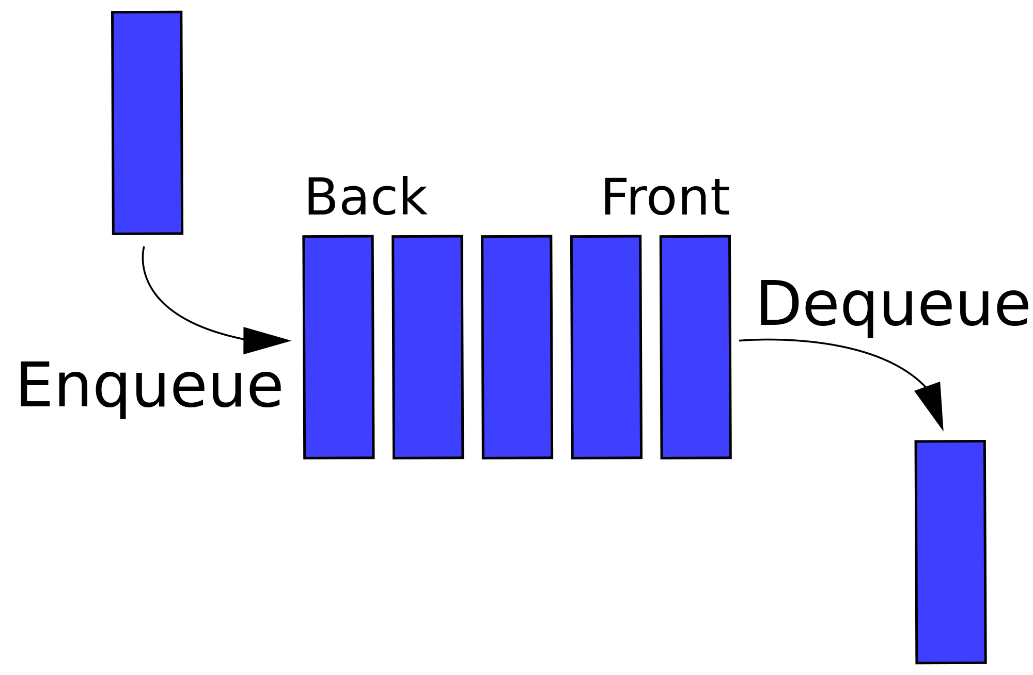
Queue

Slide 15
Queue
class Queue<T>
{
// Appends an elements at the end of the queue
void Enqueue(T data);
// Extracts the element from the start of the queue
T Dequeue();
// Checks for empty queue
bool IsEmpty();
}
// The type T can be any data structure like
// int, string, DateTime, Student

Slide 16

Queue
Start of the queue: elements
are excluded from this position
data
data
data
data
data
data
End of the queue: new elements are inserted here
data

Slide 17
Linked List
2
next
7
next
4
next
5
next
null
head
(list start)

Slide 18
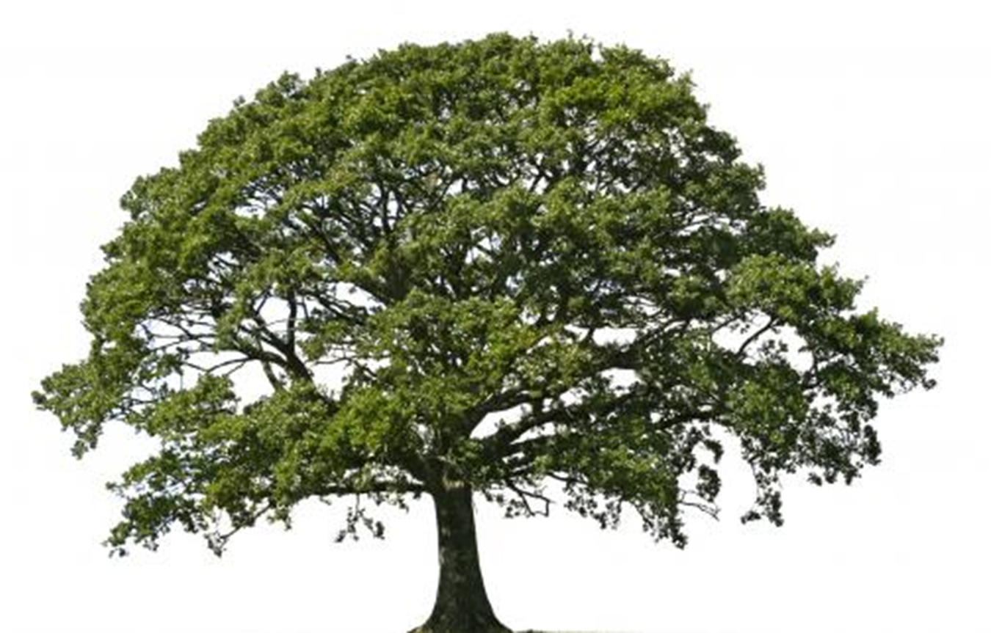
Tree

Slide 19
Trees
17
Project Manager
Team Leader
De-signer
QA Team Leader
9
14
15
Developer 1
Developer 3
Tester 1
Tester 2
6
5
8
Developer 2

Slide 20
Binary Tree
data
left link
•
.......
data
right link
•
left link
•
data
NULL
•
right link
•
left link
data
rig
ht link
•
NULL
left link
•
.......
data
right link
•
left link
•
.......
right link
•
tree root
.......
NULL

Slide 21
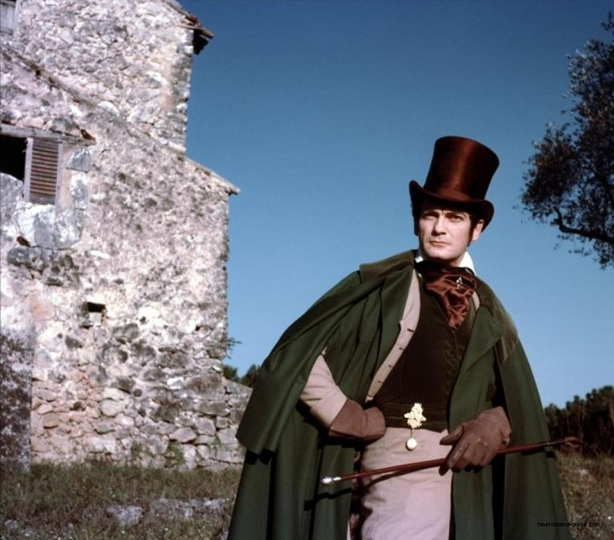
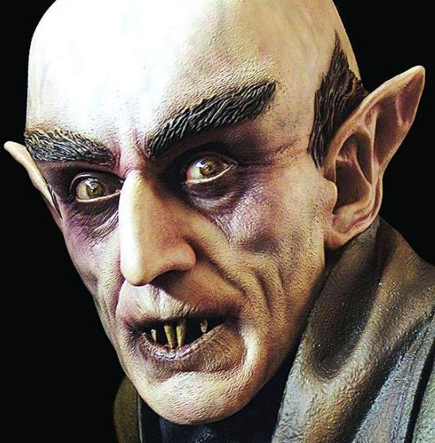
Graph

Slide 22
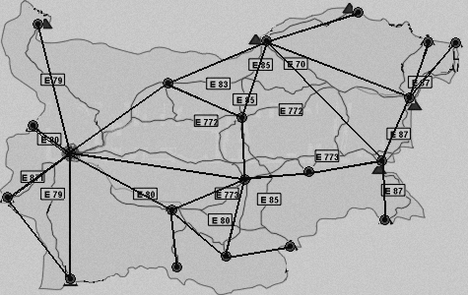
Graph

Slide 23
Graphs
7
1
14
4
21
11
12
19
31
A
F
J
D
A
G
K
G
E
C
H
H
N

Slide 24
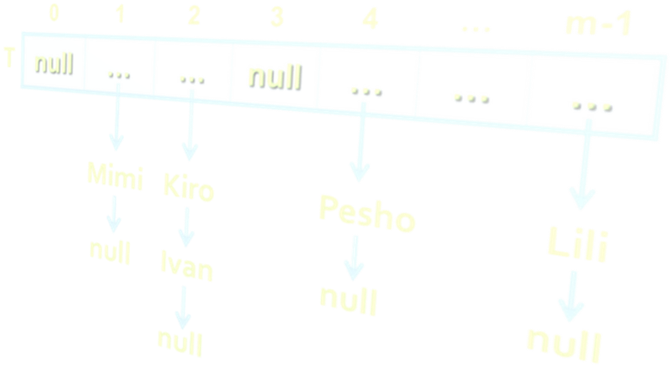

Hash-Table

Slide 25
Hash-Table: Structure
Key1
Hash-Function
Slot 0
Element1
Slot 1
Key 2
Slot 2
Element 2
……
…
Slot
n-1
Key
m
Element
m

Slide 26
Hash-Table: Chaining on Collision
0
•
NULL
1
•
123
•
NULL
2
•
234
•
235
•
NULL
3
•
NULL
4
•
NULL
5
•
567
•
534
•
NULL
6
•
647
•
NULL
7
•
NULL
8
•
NULL
9
•
NULL

Slide 27
Why Are Data Structures So Important?
Data structures and algorithms are the foundation of computer programming
Algorithmic thinking, problem solving and data structures are vital for software engineers
C# developers should know when to use T[], LinkedList<T>, List<T>, Stack<T>, Queue<T>, Dictionary<K, T>, HashSet<T>, SortedDictionary<K, T> and SortedSet<T>
Computational complexity is important for algorithm design and efficient programming

Slide 28
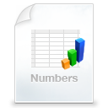
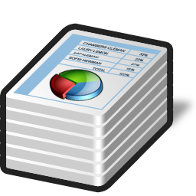

Primitive Types and Collections
Primitive data types
Numbers: int, float, double, decimal, …
Text data: char, string, …
Simple structures
A group of primitive fields stored together
E.g. DateTime, Point, Rectangle, Color, …
Collections
A set / sequence of elements (of the same type)
E.g. array, list, stack, queue, tree, hashtable, bag, …

Slide 29

Abstract Data Types (ADT)
An Abstract Data Type (ADT) is
A data type together with the operations, whose properties are specified independently of any particular implementation
ADT is a set of definitions of operations
Like the interfaces in C# / Java
Defines what we can do with the structure
ADT can have several different implementations
Different implementations can have different efficiency, inner logic and resource needs
abstract data

Slide 30

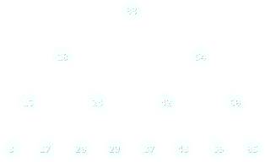

Basic Data Structures
Linear structures
Lists: fixed size and variable size sequences
Stacks: LIFO (Last In First Out) structures
Queues: FIFO (First In First Out) structures
Trees and tree-like structures
Binary, ordered search trees, balanced trees, etc.
Dictionaries (maps, associative arrays)
Hold pairs (key → value)
Hash tables: use hash functions to search / insert

Slide 31



Basic Data Structures (2)
Sets, multi-sets and bags
Set – collection of unique elements
Bag – collection of non-unique elements
Ordered sets and dictionaries
Priority queues / heaps
Special tree structures
Suffix tree, interval tree, index tree, trie, rope, …
Graphs
Directed / undirected, weighted / unweighted, connected / non-connected, cyclic / acyclic, …

Slide 32



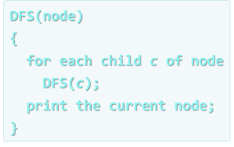
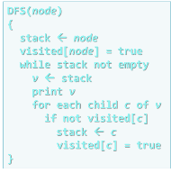

Algorithms
Overview

Slide 33
What is an Algorithm?
“In mathematics and computer science, an algorithm is a step-by-step procedure for calculations. An algorithm is an effective method expressed as a finite list of well-defined instructions for calculating a function.”
-- Wikipedia
The term "algorithm" means "a sequence of steps"
Derived from Muḥammad Al-Khwārizmī', a Persian mathematician and astronomer
He described an algorithm for solving quadratic equations in 825

Slide 34
Algorithms in Computer Science
Algorithms are fundamental in programming
Imperative (traditional, algorithmic) programming means to describe in formal steps how to do something
Algorithm == sequence of operations (steps)
Can include branches (conditional blocks) and repeated logic (loops)
Algorithmic thinking (mathematical thinking, logical thinking, engineering thinking)
Ability to decompose the problems into formal sequences of steps (algorithms)

Slide 35
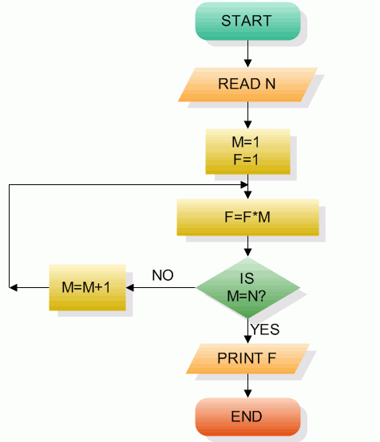
Pseudocode and Flowcharts
Algorithms can be expressed as pseudocode, through flowcharts or program code
BFS(node)
{
queue ← node
while queue not empty
v ← queue
print v
for each child c of v
queue ← c
}
public void DFS(Node node)
{
Print(node.Name);
for (int i = 0; i < node.
Children.Count; i++)
{
if (!visited[node.Id])
DFS(node.Children[i]);
}
visited[node.Id] = true;
}
Pseudo-code
Flowchart
Source code

Slide 36


Some Algorithms in Programming
Sorting and searching
Dynamic programming
Graph algorithms
DFS and BFS traversals
Combinatorial algorithms
Recursive algorithms
Other algorithms
Greedy algorithms, computational geometry, randomized algorithms, parallel algorithms, genetic algorithms

Slide 37

Algorithm Complexity
Asymptotic Notation

Slide 38
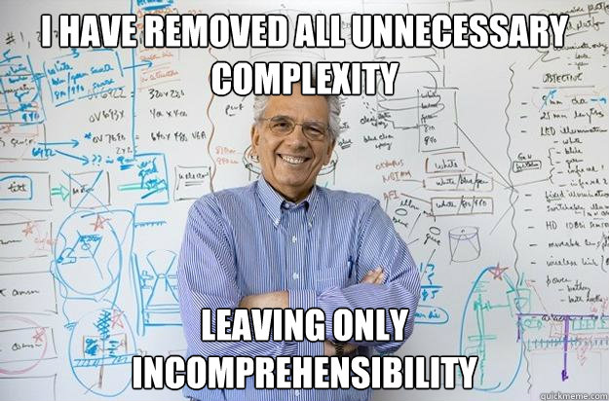

Slide 39



Algorithm Analysis
Why should we analyze algorithms?
Predict the resources the algorithm will need
Computational time (CPU consumption)
Memory space (RAM consumption)
Communication bandwidth consumption
The expected running time of an algorithm is:
The total number of primitive operations executed (machine independent steps)
Also known as algorithm complexity

Slide 40
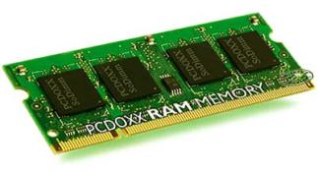
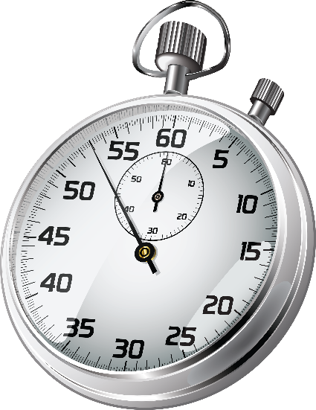
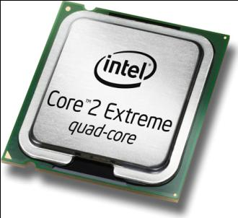
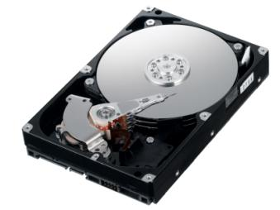
Algorithmic Complexity
What to measure?
CPU time
Memory consumption
Number of steps
Number of particular operations
Number of disk operations
Number of network packets
Asymptotic complexity

Slide 41
Time Complexity
Worst-case
An upper bound on the running time for any input of given size
Typically algorithms performance is measured for their worst case
Average-case
The running time averaged over all possible inputs
Used to measure algorithms that are repeated many times
Best-case
The lower bound on the running time (the optimal case)

Slide 42

Time Complexity: Example
Sequential search in a list of size n
Worst-case:
n comparisons
Best-case:
1 comparison
Average-case:
n/2 comparisons
The algorithm runs in linear time
Linear number of operations
… | … | … | … | … | … | …
n

Slide 43
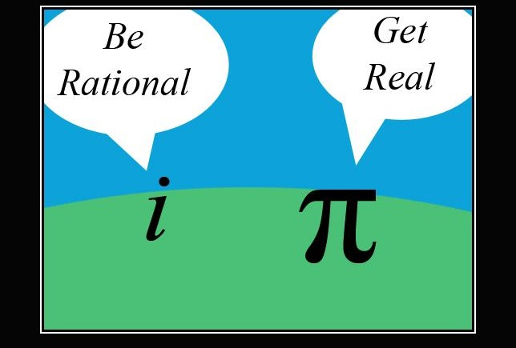
Warning: Math Ahead!

Slide 44

Warning: Math Can be Hard!

Slide 45
Algorithms Complexity
Algorithm complexity is a rough estimation of the number of steps performed by given computation, depending on the size of the input
Measured with asymptotic notation
O(g) where g is a function of the size of the input data
Examples:
Linear complexity O(n)
All elements are processed once (or constant number of times)
Quadratic complexity O(n²)
Each of the elements is processed n times

Slide 46
Asymptotic Notation: Definition
Asymptotic upper bound
O-notation (Big O notation)
For a given function g(n), we denote by O(g(n)) the set of functions that are different than g(n) by a constant
Examples:
3 * n² + n/2 + 12 ∈ O(n²)
4*n*log₂(3*n+1) + 2*n-1 ∈ O(n * log n)
O(g(n)) = {f(n): there exist positive constants c and n₀ such that f(n) <= c*g(n) for all n >= n₀}

Slide 47
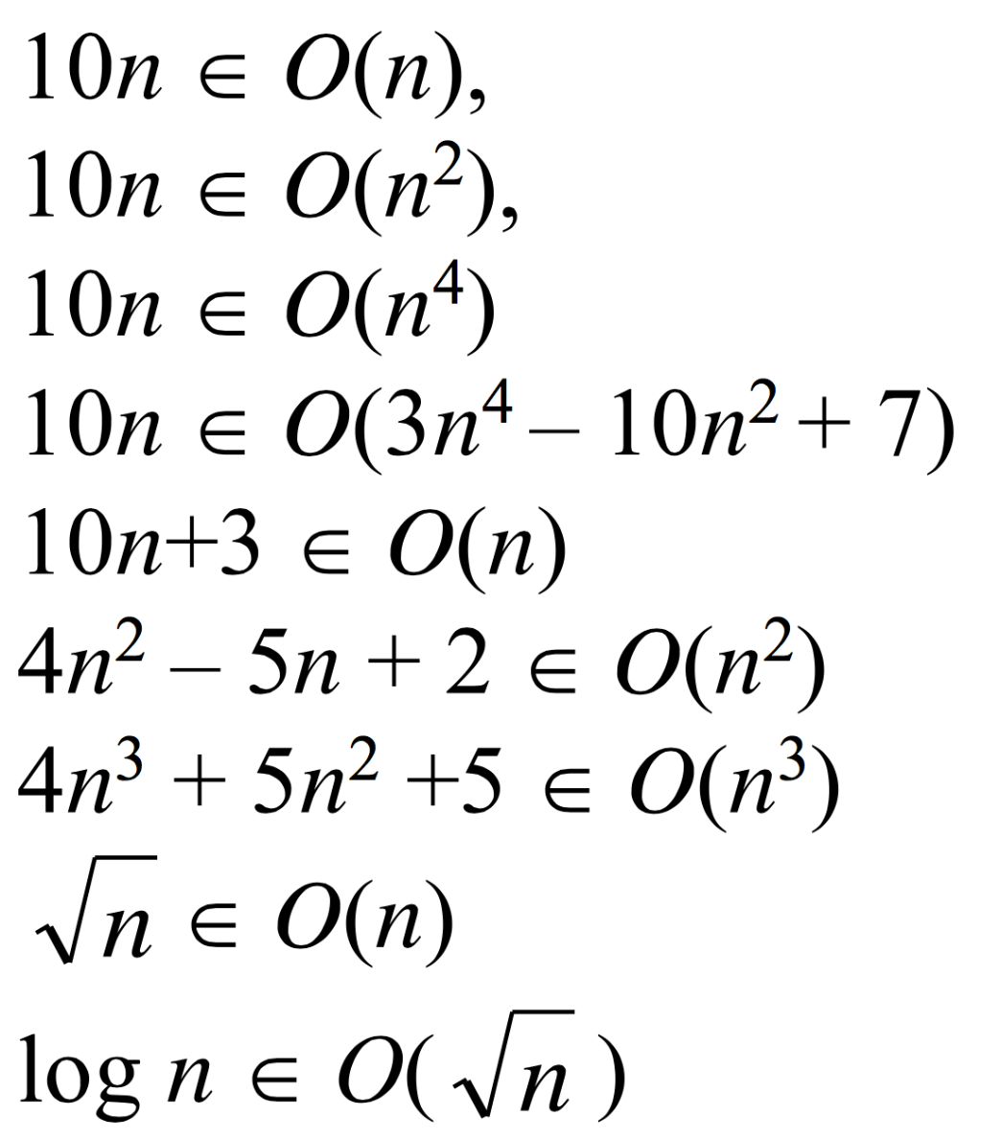
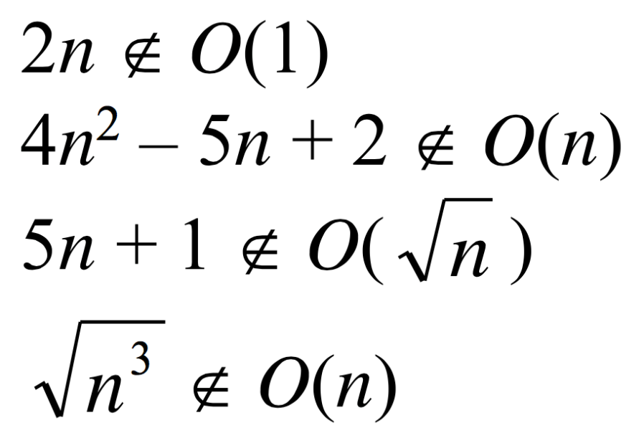
Examples
Positive examples:
Negative examples:

Slide 48
Asymptotic Functions

Slide 49
Typical Complexities
Complexity | Notation | Description
constant | O(1) | Constant number of operations, not depending on the input data size, e.g. n = 1 000 000 → 1-2 operations
logarithmic | O(log n) | Number of operations proportional to log₂(n) where n is the size of the input data, e.g. n = 1 000 000 000 → 30 operations
linear | O(n) | Number of operations proportional to the input data size, e.g. n = 10 000 → 5 000 operations

Slide 50
Typical Complexities (2)
Complexity | Notation | Description
quadratic | O(n²) | Number of operations proportional to the square of the size of the input data, e.g. n = 500 → 250 000 operations
cubic | O(n³) | Number of operations propor-tional to the cube of the size of the input data, e.g. n = 200 → 8 000 000 operations
exponential | O(2^{n}), O(k^{n}), O(n!) | Exponential number of operations, fast growing, e.g. n = 20 → 1 048 576 operations

Slide 51
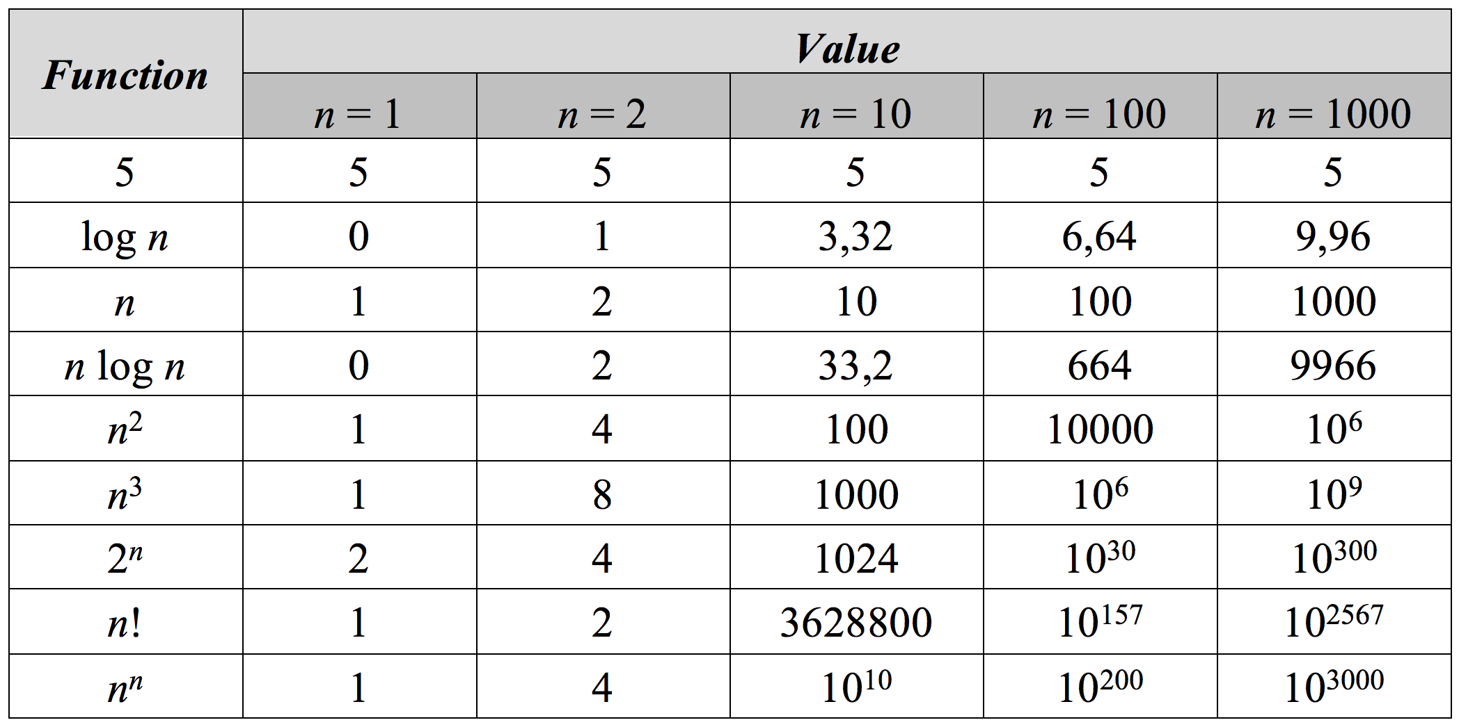
Function Values

Slide 52
Time Complexity and Program Speed
Complexity | 10 | 20 | 50 | 100 | 1 000 | 10 000 | 100 000
O(1) | < 1 s | < 1 s | < 1 s | < 1 s | < 1 s | < 1 s | < 1 s
O(log(n)) | < 1 s | < 1 s | < 1 s | < 1 s | < 1 s | < 1 s | < 1 s
O(n) | < 1 s | < 1 s | < 1 s | < 1 s | < 1 s | < 1 s | < 1 s
O(n*log(n)) | < 1 s | < 1 s | < 1 s | < 1 s | < 1 s | < 1 s | < 1 s
O(n²) | < 1 s | < 1 s | < 1 s | < 1 s | < 1 s | 2 s | 3-4 min
O(n³) | < 1 s | < 1 s | < 1 s | < 1 s | 20 s | 5 hours | 231 days
O(2^{n}) | < 1 s | < 1 s | 260 days | hangs | hangs | hangs | hangs
O(n!) | < 1 s | hangs | hangs | hangs | hangs | hangs | hangs
O(n^{n}) | 3-4 min | hangs | hangs | hangs | hangs | hangs | hangs

Slide 53
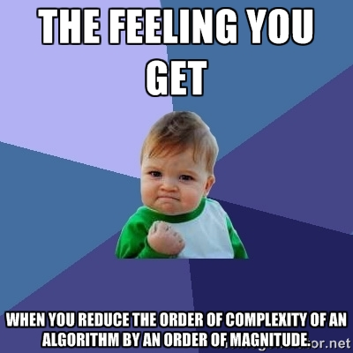

Slide 54
Time and Memory Complexity
Complexity can be expressed as a formula of multiple variables, e.g.
Algorithm filling a matrix of size n * m with the natural numbers 1, 2, … n*m will run in O(n*m)
Algorithms to traverse a graph with n vertices and m edges will take O(n + m) steps
Memory consumption should also be considered, for example:
Running time O(n) & memory requirement O(n²)
n = 50 000 → OutOfMemoryException
BTW: Is it possible in practice? In theory?

Slide 55
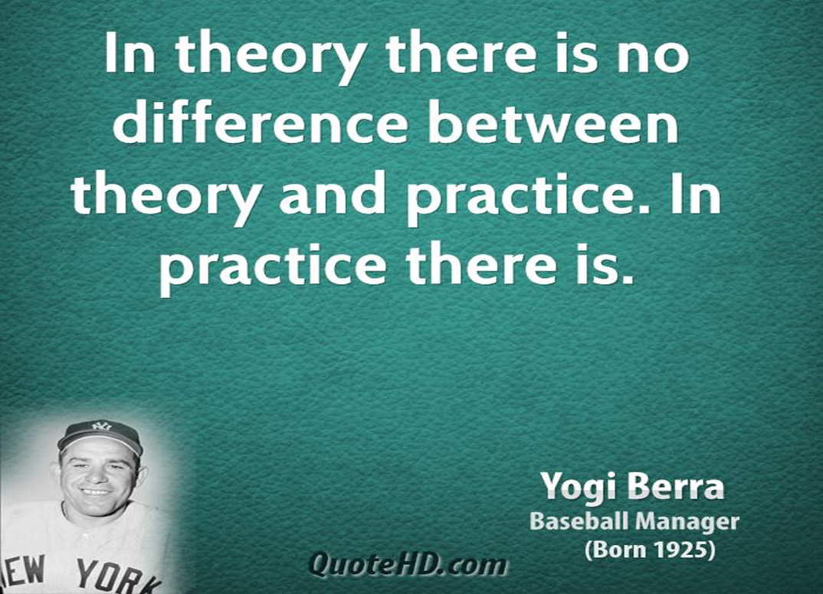
Theory vs. Practice

Slide 56
The Hidden Constant
A linear algorithm could be slower than a quadratic algorithm
The hidden constant could be significant
Example:
Algorithm A performs 100*n steps → O(n)
Algorithm B performs n*(n-1)/2 steps → O(n²)
For n < 200, algorithm B is faster
Real-world example:
The "insertion sort" is faster than "quicksort" for n < 9

Slide 57
Amortized Analysis
void AddOne(char[] chars, int m)
{
for (int i = 0; 1 != chars[i] && i < m; i++)
{
c[i] = 1 - c[i];
}
}
Worst case: O(n²)
Average case: O(n) – Why?

Slide 58
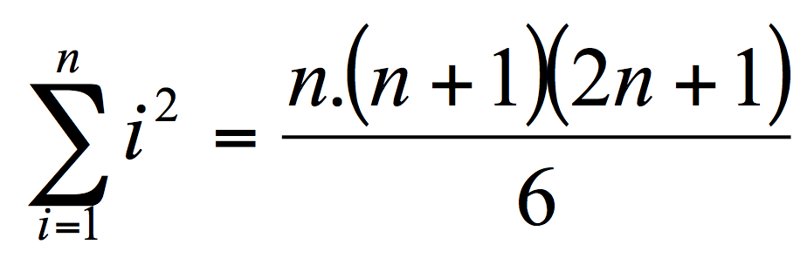
Using Math
sum = 0;
for (i = 1; i <= n; i++)
{
for (j = 1; j <= i*i; j++)
{
sum++;
}
}
Complexity: O(n³)

Slide 59
Using a Barometer
uint sum = 0;
for (i = 0; i < n; i++)
{
for (j = 0; j < i*i; j++)
{
sum++;
}
}
Console.WriteLine(sum);
Just calculate and print sum = n * (n + 1) * (2n + 1) / 6

Slide 60
Polynomial Algorithms
A polynomial-time algorithm has worst-case time complexity bounded above by a polynomial function of its input size
Examples:
Polynomial time: 2n, 3n³ + 4n
Exponential time: 2^{n}, 3^{n}, n^{k}, n!
Exponential algorithms hang for large input data sets
W(n) ∈ O(p(n))

Slide 61
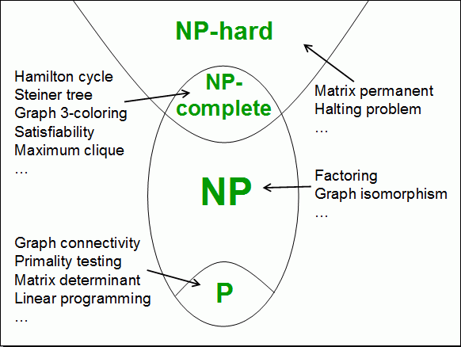
Computational Classes
Computational complexity theory divides the computational problems into several classes:

Slide 62
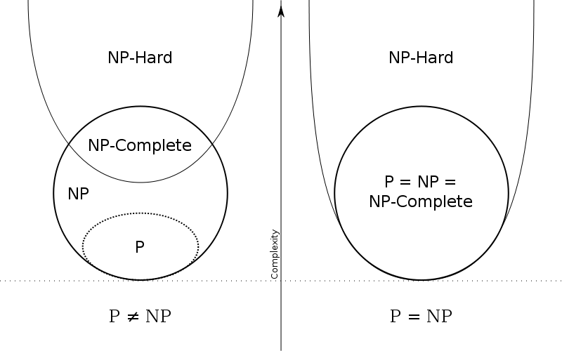
P vs. NP: Problem #1 in Computer Science Today

Slide 63

Analyzing the Complexity of Algorithms
O(n)
O(n+m)
O(n²)
O(n!)
O(n*m)
Examples

Slide 64
Complexity Examples
int FindMaxElement(int[] array)
{
int max = array[0];
for (int i=1; i<array.length; i++)
{
if (array[i] > max)
{
max = array[i];
}
}
return max;
}
Runs in O(n) where n is the size of the array
The number of elementary steps is ~ n

Slide 65
Complexity Examples (2)
long FindInversions(int[] array)
{
long inversions = 0;
for (int i=0; i<array.Length; i++)
for (int j = i+1; j<array.Length; i++)
if (array[i] > array[j])
inversions++;
return inversions;
}
Runs in O(n²) where n is the size of the array
The number of elementary steps is ~ n * (n+1) / 2

Slide 66
Complexity Examples (3)
decimal Sum3(int n)
{
decimal sum = 0;
for (int a=0; a<n; a++)
for (int b=0; b<n; b++)
for (int c=0; c<n; c++)
sum += a*b*c;
return sum;
}
Runs in cubic time O(n³)
The number of elementary steps is ~ n³

Slide 67
Complexity Examples (4)
long SumMN(int n, int m)
{
long sum = 0;
for (int x=0; x<n; x++)
for (int y=0; y<m; y++)
sum += x*y;
return sum;
}
Runs in quadratic time O(n*m)
The number of elementary steps is ~ n*m

Slide 68
Complexity Examples (5)
long SumMN(int n, int m)
{
long sum = 0;
for (int x=0; x<n; x++)
for (int y=0; y<m; y++)
if (x==y)
for (int i=0; i<n; i++)
sum += i*x*y;
return sum;
}
Runs in quadratic time O(n*m)
The number of elementary steps is ~ n*m + min(m,n)*n

Slide 69
Complexity Examples (6)
decimal Calculation(int n)
{
decimal result = 0;
for (int i = 0; i < (1<<n); i++)
result += i;
return result;
}
Runs in exponential time O(2^{n})
The number of elementary steps is ~ 2^{n}

Slide 70
Complexity Examples (7)
decimal Factorial(int n)
{
if (n==0)
return 1;
else
return n * Factorial(n-1);
}
Runs in linear time O(n)
The number of elementary steps is ~ n

Slide 71
Complexity Examples (8)
decimal Fibonacci(int n)
{
if (n == 0)
return 1;
else if (n == 1)
return 1;
else
return Fibonacci(n-1) + Fibonacci(n-2);
}
Runs in exponential time O(2^{n})
The number of elementary steps is ~ Fib(n+1) where Fib(k) is the k^{th} Fibonacci's number

Slide 72
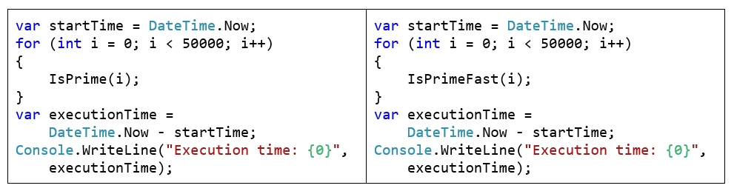
Lab Exercise
Calculating Complexity of Existing Code

Slide 73
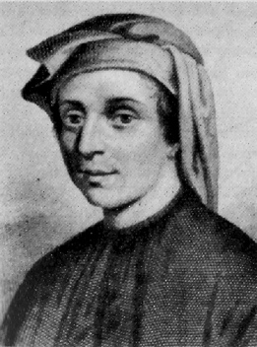
Leonardo Fibonacci

Slide 74
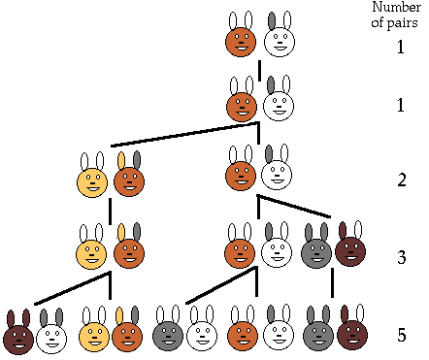
Fibonacci Numbers

Slide 75
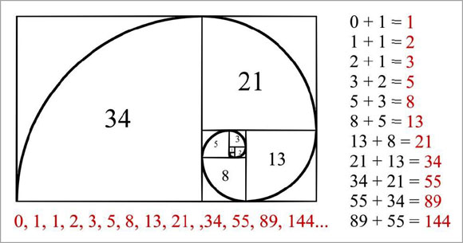
Fibonacci Numbers

Slide 76
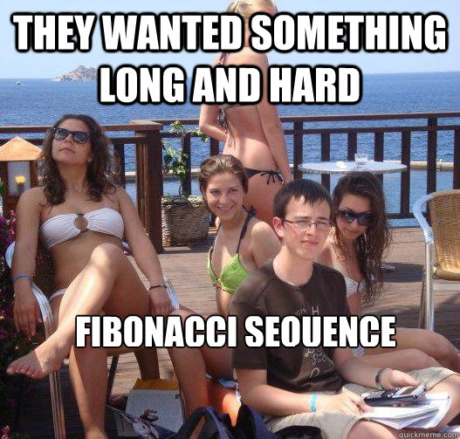
Fibonacci Numbers

Slide 77
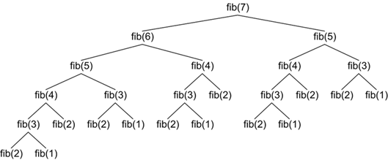
Fibonacci Numbers

Slide 78
Summary
Data structures organize data in computer systems for efficient use
Abstract data types (ADT) describe a set of operations
Collections hold a group of elements
Algorithms are sequences of steps for calculating / doing something
Algorithm complexity is a rough estimation of the number of steps performed by given computation
Can be logarithmic, linear, n log n, square, cubic, exponential, etc.
Complexity predicts the speed of given code before its execution

Slide 79
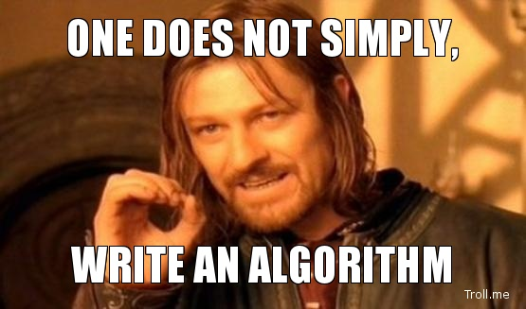

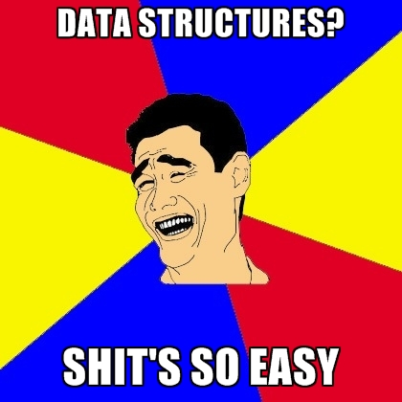

Slide 80









Data Structures, Algorithms and Complexity
https://softuni.bg/trainings/1147/Data-Structures-June-2015

Slide 81
License
This course (slides, examples, labs, videos, homework, etc.) is licensed under the "Creative Commons Attribution-NonCommercial-ShareAlike 4.0 International" license
Attribution: this work may contain portions from
"Fundamentals of Computer Programming with C#" book by Svetlin Nakov & Co. under CC-BY-SA license
"Data Structures and Algorithms" course by Telerik Academy under CC-BY-NC-SA license

Slide 82






Free Trainings @ Software University
Software University Foundation – softuni.org
Software University – High-Quality Education, Profession and Job for Software Developers
softuni.bg
Software University @ Facebook
facebook.com/SoftwareUniversity
Software University @ YouTube
youtube.com/SoftwareUniversity
Software University Forums – forum.softuni.bg

